Slide 1
Face Recognition using Siamese Neural Networks

Slide 2
Introduction
Deep neural network
Siamese neural networks
Convolutional neural networks
Convolution layer
Activation function
Pooling
Batch normalization
Fully connected layers
Loss function
Optimizer
ResNet
Architecture
Experimental Results
Conclusion

Slide 3
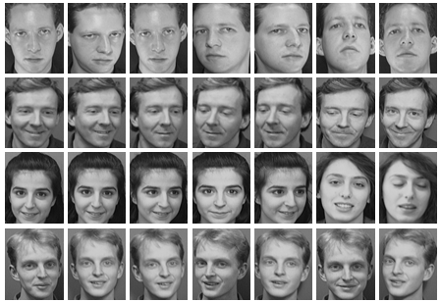
Face Matching
Independent of small rotations, horizontal flipping, lightning and scaling
Training data from The Database of Faces (AT&T), 40 persons, 10 images per person
67.5% training, 32.5% test
Notes:
Facial Recognition is widely used, from biometric authentication to authorities looking for crimininals and terrorists. During my internship I was introduced to neural networks, in peculiar to siamese neural networks and convolutional neural networks. The dataset I used is a dataset of 10 pictures per person and 40 persons so 400 images in total.

Slide 4
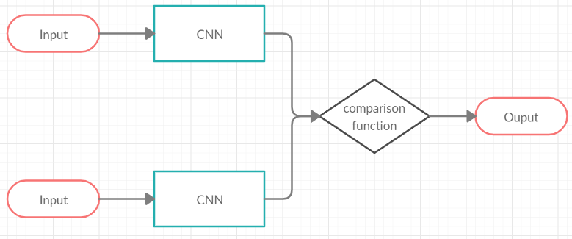
Siamese Neural Networks
The 2 inputs (images) are passed through the SAME CNN
Then passed along a comparision function, usually euclidean distance
Finally the loss can be calculated from the output
And the parameters can be updated accordingly to the gradient descent
Notes:
A siamese network is a network which requires 2 inputs (images), these inputs produce outputs which are compared. Usually the euclidean distance is used as comparision function between the two vectors (or points on the manifold). Similar faces/inputs produce close points on the manifold, and a low euclidean distance. While dissimilar faces produce distant points on the manifold. Then we use a loss function, I tried out 2 loss functions but there are many more. Finally during backpropagation the network’s parameters get updated.

Slide 5
Convolutional Neural Network (CNN)
Feature Extraction
Classification
Automatic feature extraction via machine learning
Spatial dependencies are preserved
Convolution layers reduce number of parameters, allowing the network to have more layers (deep neural network) without overfitting
Notes:
Not so long ago data scientist manually crafted filters to extract features from images, this type of work is hard and takes a lot of time, so with machine learning the feature extraction filters are learned. A big advantage of using CNN instead of classic neural networks, is that the relation with neighbouring pixels is preserved. And since the number of parameters in a convolutional network are much smaller, we can build deeper networks, so-called deep neural networks

Slide 6
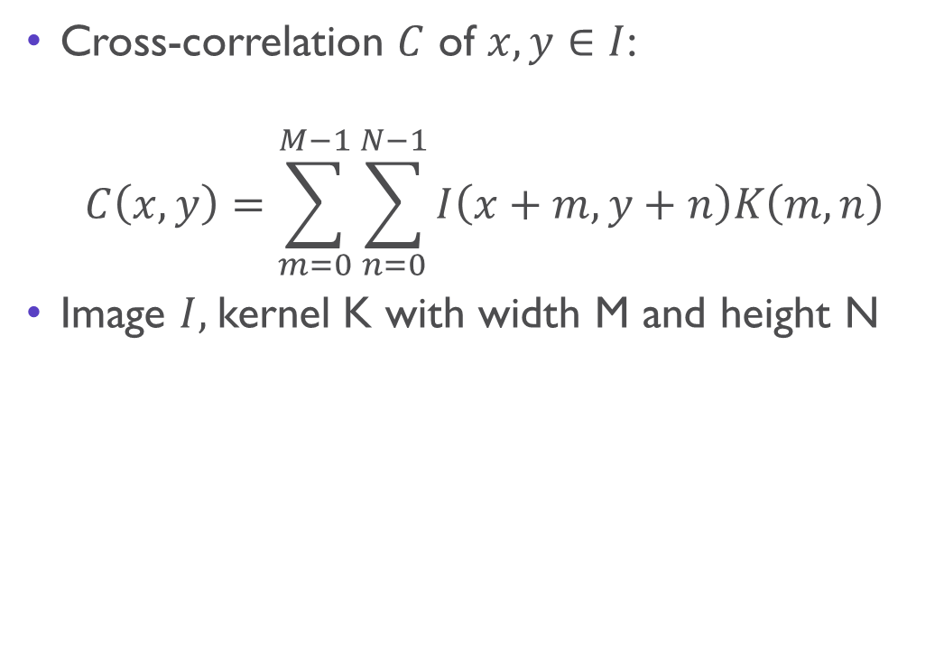

Convolution Layer
Cross-correlation $C$ of $x,y∈I$:
$$C\left(x,y\right)=\sum_{m=0}^{M−1}{\sum_{n=0}^{N−1}{I\left(x+m,y+n\right)K\left(m,n\right)}}$$
Image $I,$kernel K with width M and height N
1 | 0 | 1
0 | 1 | 0
1 | 0 | 1
$K$ =
Notes:
https://www.quora.com/Why-are-convolutional-nets-called-so-when-they-are-actually-doing-correlations
Each element of the convolved featured is computed by elementwise multiplying a sector of the image with the kernel, if you have a third dimension, a depth, you need to sum the results and finally add a bias. Some hyper parameters of the kernel, are its size and stride. Since the kernel is a constant for each depth slice, convolutions are independent of translations of the feature in the image.
Parameters are shared within each depth, all neurons in this depth slice respond on certain features regardless of the position $\left(x,y\right)$in the image $I (Translation invariance)$

Slide 7
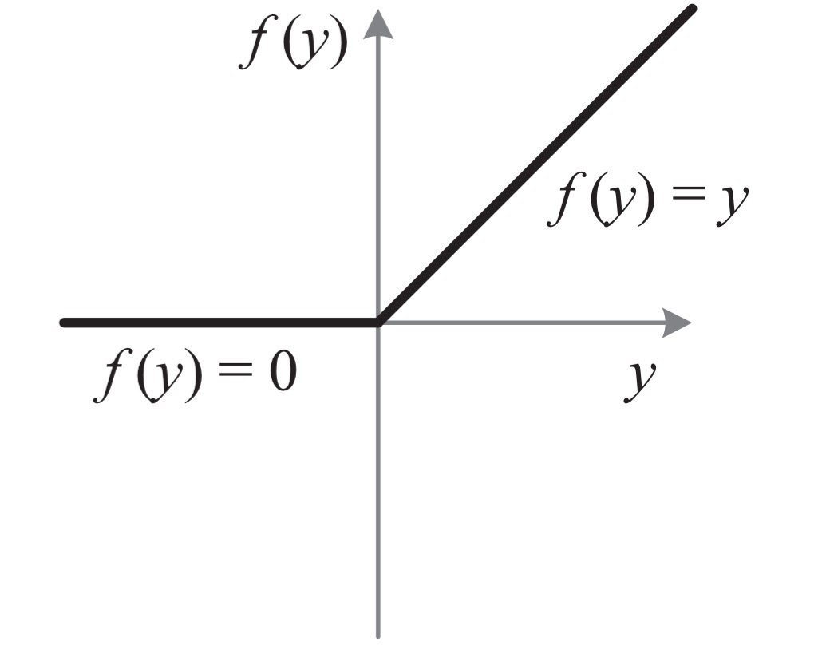

Activation Function (ReLU)
Adds needed non-linearity!
Needs to be differentiable for backpropagation
Computationally inexpensive
No vanishing gradient, ideal for deeper networks
Empirically proven to perform better than other activation functions (sigmoid, tanh)
$$f\left(y\right)=max⁡(0,y)$$
Notes:
https://www.quora.com/Why-do-neural-networks-need-an-activation-function
https://stats.stackexchange.com/questions/126238/what-are-the-advantages-of-relu-over-sigmoid-function-in-deep-neural-networks
To add non-linearity to our model, non-linear activation functions like sigmoid and ReLU are used.
And since a neural network is a linear combination of functions, we need to make sure these functions are non-linear, else the linear combination of all linear functions in the network would be a simple linear function itself. Since we want our network to be able to train, we need to make sure the activation function is differentiable. Some advantages of ReLU over others: It’s computationally inexpensive which makes training and using the model faster. Since the gradient of the ReLU function is 1 for a greater than 0, in comparison with a small gradient for functions like Sigmoid when the value of a increases, this is called the vanishing gradient problem. Another advantage is that it’s empirically proven to be better.

Slide 8
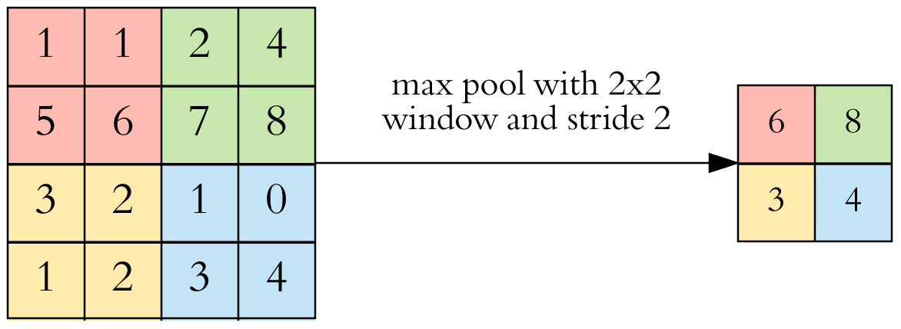
Pooling Layer (Max Pooling)
Downsampling
Reduces computations
Convolutions after pooling will “see the bigger picture” and extract higher level features
Max pooling and average pooling both have different usecases
Max pooling empirically proven to be better for CNN
Notes:
Pooling layers are used to downsample the number of features. So instead of doing the expensive convolution operation on a 4x4 matrix we can pool this matrix first then it becomes a 2x2 matrix. And then run the expensive convolution operation on it. We could say there is an even bigger advantage, that is, after pooling the image is mapped to smaller variant of itself, so the next convolution will extract higher level features.
The type of pooling I used is max pooling since it emphasizes important features more, instead of average pooling which takes everything into account.

Slide 9
Batch normalization
The mean and variance of all the inputs of a batch get calculated
Each input then gets normalized

Slide 10
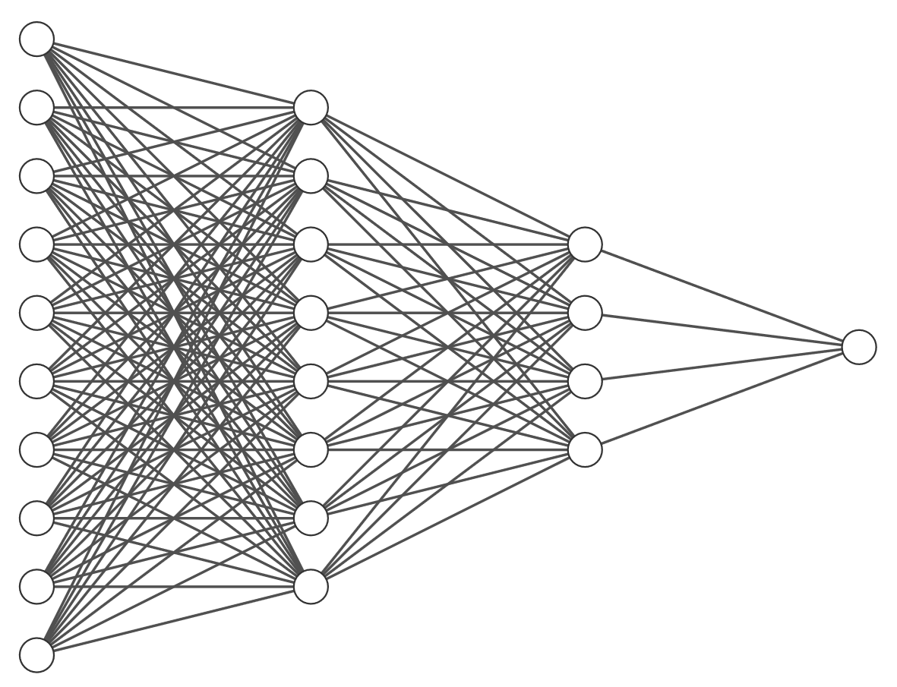
Fully-Connected Layers
Map the features onto a one-dimensional vector (flattening)
Connect every neuron in one layer to every neuron in the other (multi-layer perceptron)
Output layer is prediction, classifier or point on manifold
Notes:
The features are then mapped from a high dimensional vector to a low dimensional vector this is called flattening, then these layers are connected to eachother like in a multi-layer perceptron, to add more parameters, but we need to be careful not to add too much complexity since our dataset is relatively small (400 images). The last layer of a network is ussualy a classifying layer with the same number of neurons as classes. But for this type of task we don’t have classes. So we will want a binary ouput/prediction. Or a point mapped on manifold with reduced dimensionality but I will explain this later on. Just keep in mind that this second to last layer is then used which has multiple neurons.

Slide 11
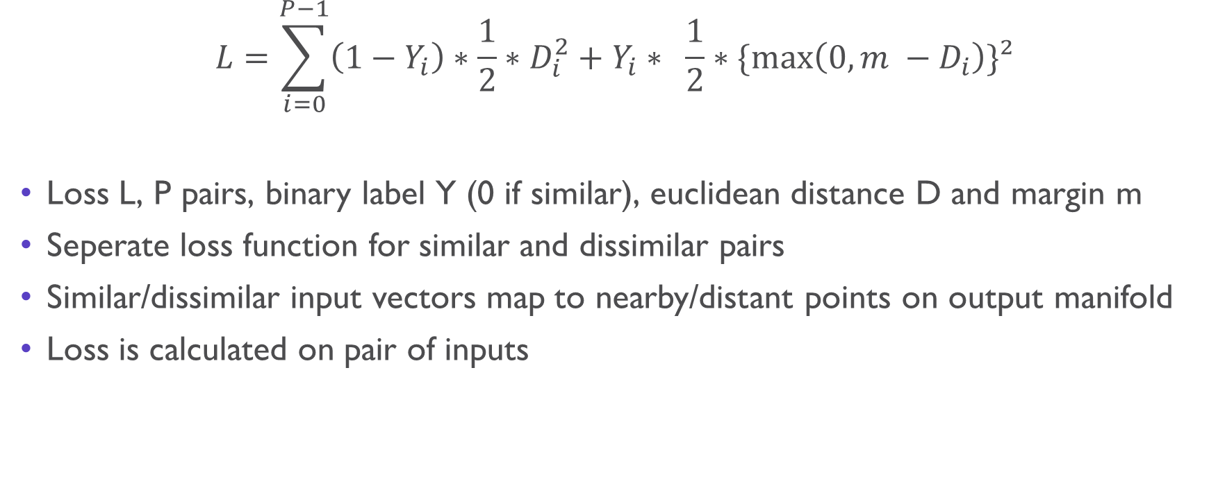
Contrastive Loss Function
$$L=\sum_{i=0}^{P−1}{\left(1−Y_{i}\right)∗\frac{1}{2}∗D_{i}^{2}+Y_{i}∗ \frac{1}{2}∗\{\max\left(0, m −D_{i}\right)\}² }$$
Loss L, P pairs, binary label Y (0 if similar), euclidean distance D and margin m
Seperate loss function for similar and dissimilar pairs
Similar/dissimilar input vectors map to nearby/distant points on output manifold
Loss is calculated on pair of inputs
Notes:
http://yann.lecun.com/exdb/publis/pdf/hadsell-chopra-lecun-06.pdf

Slide 12
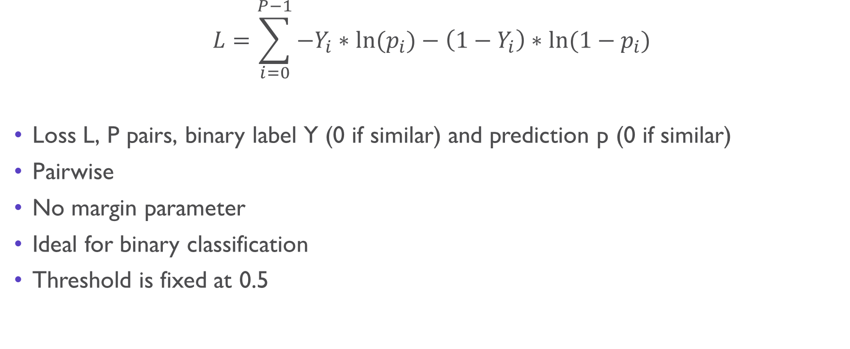
Cross Entropy Loss Function
$$L=\sum_{i=0}^{P−1}{−Y_{i}∗ln⁡(p_{i})−\left(1−Y_{i}\right)∗ln⁡(1−p_{i})}$$
Loss L, P pairs, binary label Y (0 if similar) and prediction p (0 if similar)
Pairwise
No margin parameter
Ideal for binary classification
Threshold is fixed at 0.5
Notes:
The cross entropy loss function is used when we are dealing with predictions as output instead of euclidean distances.

Slide 13
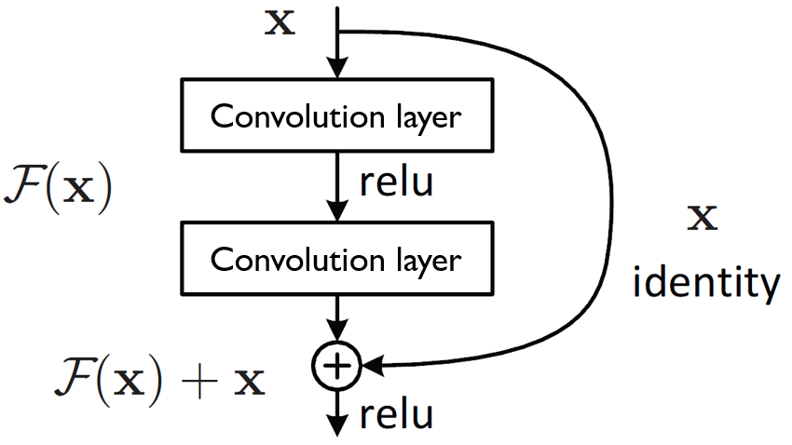
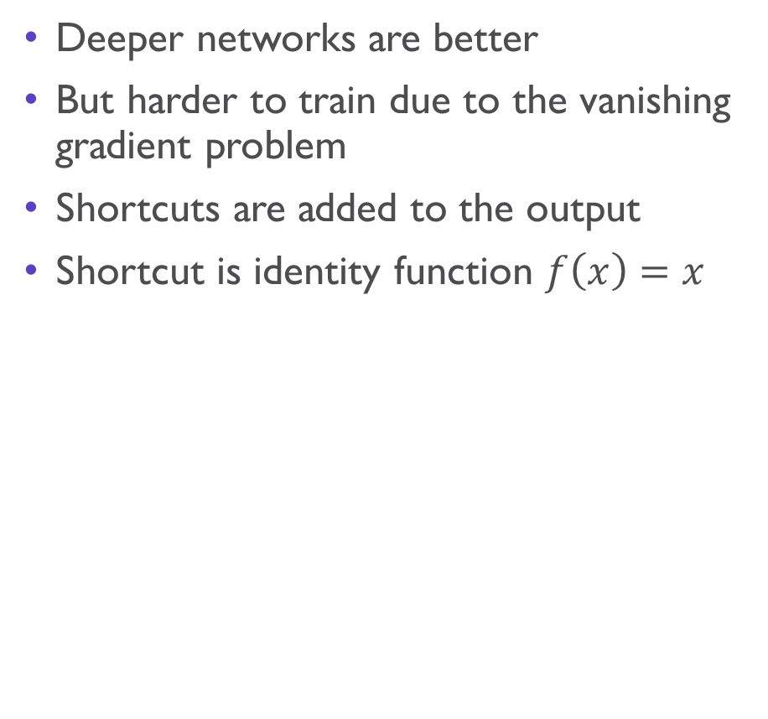
Residual Neural Networks (ResNet)
Deeper networks are better
But harder to train due to the vanishing gradient problem
Shortcuts are added to the output
Shortcut is identity function $f\left(x\right)=x$
Residual Block
Notes:
https://arxiv.org/pdf/1512.03385.pdf
A general rule of thumb is that deeper networks are better a predicting, but harder to train. Adding residual blocks to a network would allow it to go much deeper while minimizing the problems that may arise, like the vanishing gradient problem. A residual block consists of some basic convolution layers and a shortcut that is just the identity function from the input to the output of the last convolution layer where they get summed to compute the final output of the block. This way the input still has an effect on the output, independent of the intermediate layers. This preserves some link between the input and the output multiple layers further. This concept is very popular nowadays, as it achieves high accuracy.

Slide 14
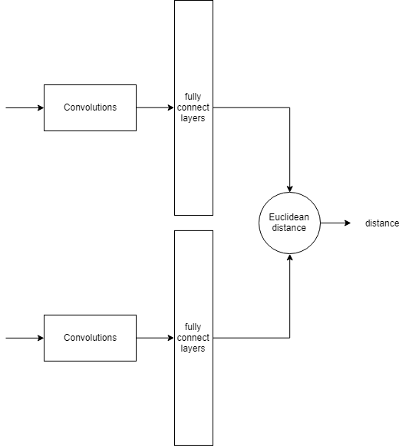
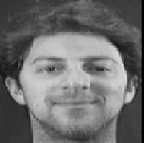
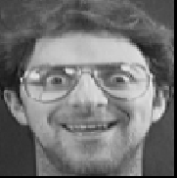


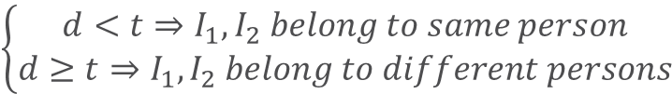

CNN + Contrastive Loss
193462 parameters
$$I_{1}$$
$$\left\{\begin{matrix}d<t⇒I_{1},I_{2} belong to same person \\ d≥t⇒{I_{1},I}_{2} belong to different persons\end{matrix}\right.$$
$$d=distance$$
$$t=threshold$$
$$I_{2}$$
Notes:
Here the comparision function is the euclidean distance operation this outputs a distance which is then compared to the threshold to determine if the pair of inputs belong to the same persons face.

Slide 15
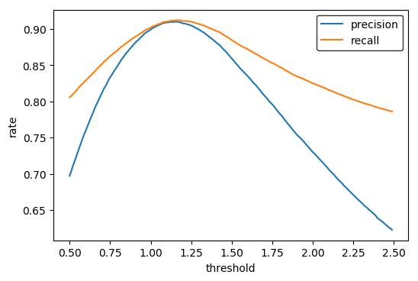
Choosing the Right Threshold
Notes:
To choose the right binary threshold I run some tests on the model and plot the recall and precision curve for a range of thresholds, then I choose whatever threshold that looks best. Here we see that a threshold around 1.15 should be acceptable.

Slide 16
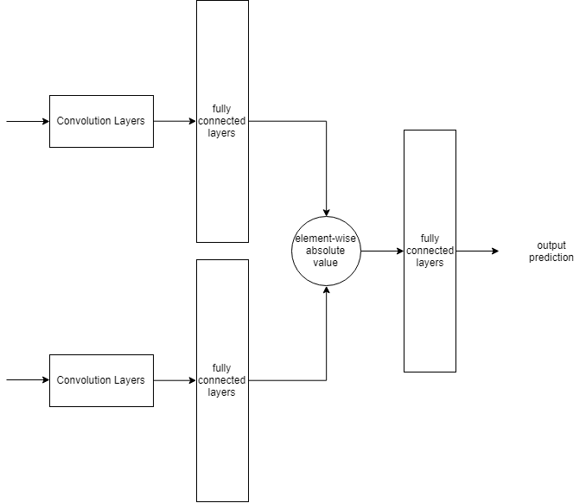



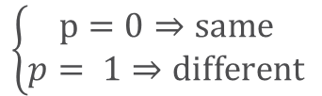
CNN + Cross Entropy Loss
193473 parameters
No threshold needed
Output is binary prediction
$$I_{1}$$
$$p$$
$$\left\{\begin{matrix}p=0⇒same \\ p= 1⇒different\end{matrix}\right.$$
$$I_{2}$$

Slide 17
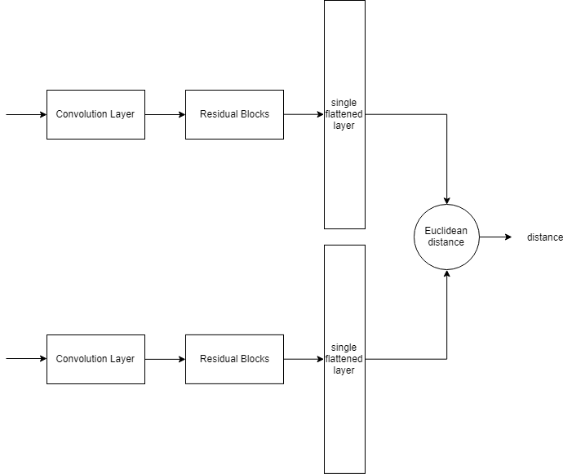



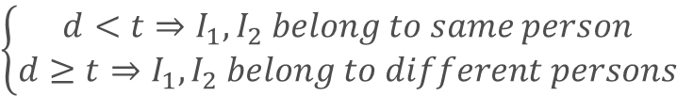
ResNet + Contrastive Loss
29832 parameters
$$\left\{\begin{matrix}d<t⇒I_{1},I_{2} belong to same person \\ d≥t⇒{I_{1},I}_{2} belong to different persons\end{matrix}\right.$$
$$I_{1}$$
$$d=distance$$
$$t=threshold$$
$$I_{2}$$

Slide 18
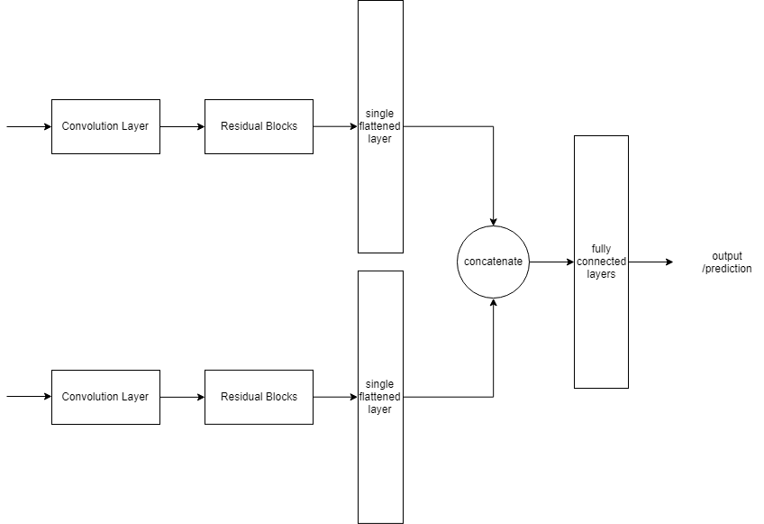

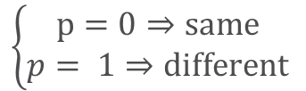


ResNet + Cross Entropy Loss
30057 parameters
$$I_{1}$$
$$p$$
$$\left\{\begin{matrix}p=0⇒same \\ p= 1⇒different\end{matrix}\right.$$
$$I_{2}$$

Slide 19
Results
Models + Loss | Accuracy | Precision | Recall | F-score
CNN + CL | 89.20% | 89.22% | 89.20% | 89.20%
CNN + CEL | 81.94% | 82.42% | 81.94% | 81.88%
RESNET + CL | 91.06% | 91.15% | 91.06% | 91.06%
RESNET + CEL | 74.13% | 76.04% | 74.13% | 73.69%
Notes:
I also tested my the RESNET + CL model on the MNIST dataset where it achieved an accuracy of around 98.73 % after only 4 epochs of training.

